Slide 1
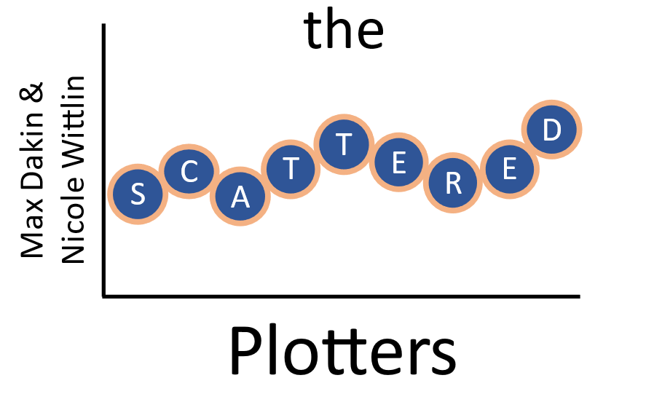
We, the Scattered Plotters, are pleased to present our data visualization dashboard as part of the 2020 Challenge. Please note the following assumptions we made as part of reporting fundraising progress.
This is intended to be a high-level Quarterly Dashboard for the college president to quickly understand fundraising progress and upcoming quarter priorities for all fundraising programs (major donors and annual fund).
This report is rarely presented in person. Typical presentation is by email (likely, printed by president’s support team and included in materials to review).
The development team leadership would follow-up with president’s office to schedule donor calls and provide information. Also, travel plans coordinated through development team leadership and president’s office.
We assumed the Fiscal Year was concurrent with the Calendar Year.
We look forward to seeing you at Data Science Now next week and are excited to compare data viz best practices with our colleagues. Thank you!!
Dollar Icon by Alice Design from the Noun Project
Contacts Icon by AliWijaya from the Noun Project

Slide 2
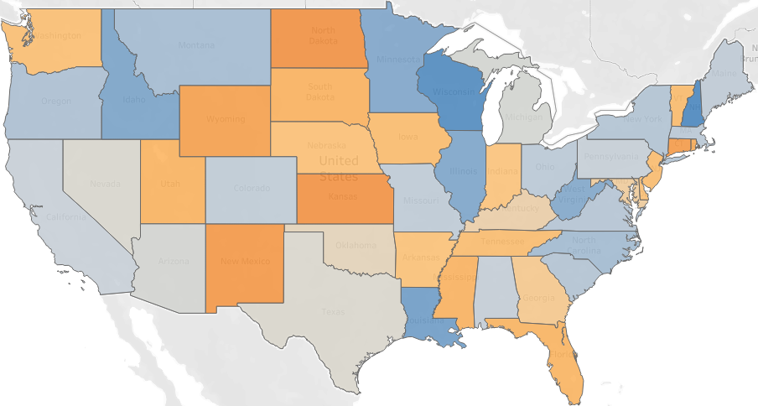
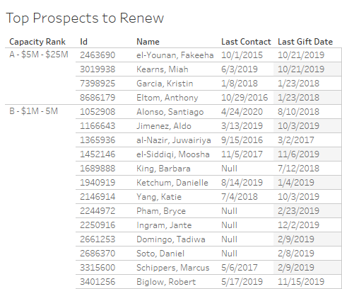
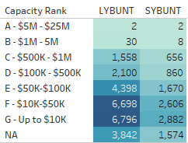
Fundraising Year to Date: Jan - Sept
Quarter 4 Priorities
$280M to raise by December 31, 2020
Target attention and travel to Midwest to renew 2019 gifts
Increase gift officer outreach by 15%: from 3.62% to 4.16%
Continue to decrease non-contacted portfolio %
Annual Fund focus on 2019 LYBUNT renewals for year ends
Leadership focus on high-capacity LYBUNT, SYBUNT renewals
Begin planning for portfolio redistribution in early 2021
2020 Goal: $1.15B
2018
$280M to raise in Q4
2017
2020
2019
2020 YTD: $870M
2020 Dollars Raised vs 2019
Portfolio Metrics: % of Donor HH Giving and Contacted
Donated
Contacted
Opportunity in Midwest
to Renew
2019 Gifts
behind
ahead
Non-Managed Donors to Renew By Capacity
High Capacity Non-Managed Donors for Presidential Contact in Q4
Q4 Focus:
Leadership Attention
Annual Fund
Outreach
Development to provide talking points and contact info.
Development leadership to contact remaining list.

